Slide 1
Digital Marketing Project Crafting Compelling Web Presences
Balaji G

Slide 2
Website and products selected
Website Link : https://www.oracle.com/
Oracle Database
Oracle Cloud Infrastructure (OCI)
Oracle Fusion Applications

Slide 3
Oracle Database
Oracle Database, often referred to simply as Oracle, is a relational database management system (RDBMS) developed and marketed by Oracle Corporation. It's one of the most widely used database systems in the world, known for its robustness, scalability, and comprehensive feature set. Here are some key points about Oracle Database:
Architecture: Oracle Database follows a client-server architecture, where the database server manages and stores data, and clients interact with the database through SQL queries and transactions.
Data Model: Oracle Database supports a relational data model, allowing data to be organized into tables with rows and columns. It also supports complex data types, such as objects, arrays, and XML, providing flexibility in data storage.
Scalability: Oracle Database is highly scalable, capable of handling large volumes of data and supporting thousands of concurrent users. It offers features like partitioning, clustering, and parallel processing to improve performance and scalability.
Security: Security is a priority in Oracle Database. It provides robust mechanisms for authentication, authorization, and encryption to protect sensitive data from unauthorized access and ensure data integrity.

Slide 4
High Availability: Oracle Database offers features for ensuring high availability and fault tolerance, including data replication, clustering, and automatic failover mechanisms. These features help minimize downtime and ensure business continuity.
Performance Optimization: Oracle Database includes various performance optimization features such as indexing, query optimization, caching, and in-memory processing to deliver fast and efficient data retrieval and processing.
Backup and Recovery: Oracle Database provides comprehensive backup and recovery solutions to protect against data loss and corruption. It supports various backup methods, including full backups, incremental backups, and point-in-time recovery.
Advanced Functionality: Oracle Database offers a wide range of advanced functionality, including support for advanced SQL queries, stored procedures, triggers, and data warehousing features like OLAP and data mining.
Compatibility: Oracle Database is compatible with various operating systems, including Linux, Windows, and Unix-based systems. It also supports multiple programming languages and interfaces for application development and integration.
Enterprise Edition vs. Standard Edition: Oracle Database is available in different editions, with the Enterprise Edition offering the most comprehensive feature set for mission-critical applications, while the Standard Edition provides basic database functionality at a lower cost.

Slide 5
Oracle Cloud Infrastructure (OCI)
Oracle Cloud Infrastructure (OCI) is Oracle's cloud computing platform that offers a comprehensive set of infrastructure and platform services to support various workload types, from simple web applications to complex enterprise applications. Here are some key features and aspects of Oracle Cloud Infrastructure:
High-Performance Compute: OCI provides high-performance compute instances optimized for various workloads, including general-purpose computing, memory-intensive applications, and high-performance computing (HPC) workloads. These instances offer powerful CPUs, high memory capacity, and fast networking to deliver superior performance.
Scalable Storage: OCI offers scalable storage options to meet the needs of different applications. This includes block storage (persistent storage volumes), object storage (for storing unstructured data such as images and backups), and file storage (for shared file systems).
Networking Services: OCI provides networking services such as virtual cloud networks (VCNs), subnets, load balancers, and VPN connectivity to create secure and scalable network architectures for applications deployed in the cloud.
Security: Security is a top priority in OCI, and it offers multiple layers of security features to protect data and resources. This includes network security (firewalls, security groups), identity and access management (IAM), encryption, and compliance certifications.

Slide 6
Integrated Platform Services: OCI offers a range of integrated platform services for application development, deployment, and management. This includes services such as container orchestration (Oracle Kubernetes Engine), serverless computing (Functions), database services (Oracle Autonomous Database), and DevOps tools (such as Developer Cloud).
Hybrid Cloud: OCI supports hybrid cloud deployments, allowing organizations to seamlessly extend their on-premises infrastructure to the cloud. This includes features such as VPN connectivity, dedicated connectivity (FastConnect), and support for hybrid cloud management tools.
Global Footprint: OCI has a global presence with data centers located in multiple regions around the world. This allows customers to deploy their applications and services closer to their users for low-latency access and compliance with data residency requirements.
Enterprise-Grade SLAs: OCI provides enterprise-grade service level agreements (SLAs) for uptime, performance, and support, ensuring reliability and availability for mission-critical workloads.
Cost-Effective Pricing: OCI offers flexible pricing models, including pay-as-you-go pricing and subscription-based models, allowing customers to optimize costs based on their usage patterns and requirements.
Integration with Oracle Ecosystem: OCI seamlessly integrates with other Oracle products and services, including Oracle databases, middleware, and applications, enabling customers to leverage their existing investments in Oracle technology and extend them to the cloud.

Slide 7
Oracle Fusion Applications
Oracle Fusion Applications is a suite of enterprise resource planning (ERP), human capital management (HCM), customer experience (CX), and supply chain management (SCM) applications developed by Oracle Corporation. It is designed to provide organizations with integrated and intelligent business solutions to streamline operations, improve decision-making, and enhance customer experience. Here are some key aspects of Oracle Fusion Applications:
Integrated Suite: Oracle Fusion Applications offer a comprehensive suite of integrated business applications that cover various functional areas including finance, procurement, project management, human resources, sales, marketing, and customer service. These applications are designed to work together seamlessly, allowing organizations to streamline processes and improve collaboration across departments.
Modern Architecture: Oracle Fusion Applications are built on a modern and scalable architecture using industry standards such as Java EE and SOA (Service-Oriented Architecture). This architecture enables flexibility, extensibility, and interoperability with other systems and applications, both within and outside the organization.
Role-Based User Experience: Fusion Applications provide role-based user interfaces that are tailored to the specific needs and responsibilities of different users within the organization. This ensures that users have access to relevant information and functionality, leading to increased productivity and efficiency.

Slide 8
Business Intelligence and Analytics: Fusion Applications include built-in business intelligence (BI) and analytics capabilities that provide real-time insights into key performance indicators (KPIs) and metrics across various business processes. This enables better decision-making and helps organizations identify opportunities for improvement.
Adaptive Intelligence: Oracle Fusion Applications leverage artificial intelligence (AI) and machine learning (ML) technologies to provide adaptive intelligence capabilities that automate routine tasks, predict outcomes, and recommend actions based on historical data and user behavior. This helps organizations improve efficiency and effectiveness in decision-making and execution.
Scalability and Flexibility: Fusion Applications are designed to scale and adapt to the changing needs and requirements of organizations of all sizes and industries. They support flexible deployment options, including on-premises, cloud, and hybrid deployments, allowing organizations to choose the deployment model that best suits their business needs.
Security and Compliance: Oracle Fusion Applications prioritize security and compliance, incorporating robust security features and controls to protect sensitive data and ensure regulatory compliance. This includes data encryption, access controls, audit trails, and compliance with industry standards and regulations.
Continuous Innovation: Oracle continuously invests in the development and enhancement of Fusion Applications, delivering regular updates, patches, and new features to address evolving business challenges and industry trends. This ensures that organizations using Fusion Applications can stay competitive and take advantage of the latest advancements in technology and functionality.

Slide 9
Website Design and Mobile Optimization

Slide 10
Tools used for website Design and Mobile Optimization
Website Design : Wappalyzer
Mobile optimization : Window Resizer, Inspect Mode

Slide 11
Test Result
Miscellaneous: Webpack, Module Federation
Analytics: Adobe Analytics
Security: Akamai Bot Manager, Akamai
CDN: Akamai
Marketing automation: Eloqua
Tag managers: Tealium
JavaScript libraries: jQuery, core-js, Boomerang
Cookie compliance: TrustArc
A/B testing: Boomerang, Akamai mPulse
Real User Monitoring (RUM): Tealium
Feature management: React, Next.js
Segmentation: Next.js
Hosting: Node.js
Performance: Next.js
JavaScript frameworks: React, Next.js
Web servers: Node.js
Video players: VideoJS
Web frameworks: React, Next.js
Caching: Next.js
UI frameworks: React
Programming languages: JavaScript

Slide 12
Test Results
Yes, the website is mobile optimized Below slides are Attached with the Below Slide
Home Page
Oracle Database
Oracle Cloud Infrastructure (OCI)
Oracle Fusion Applications

Slide 13
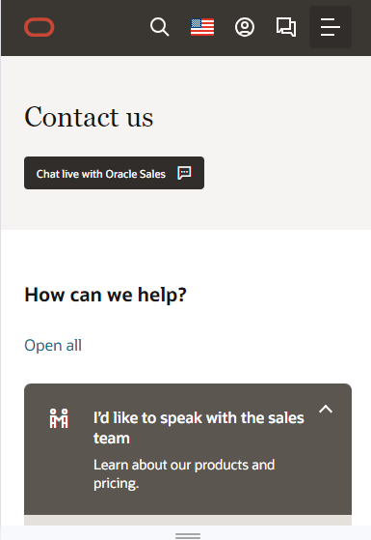
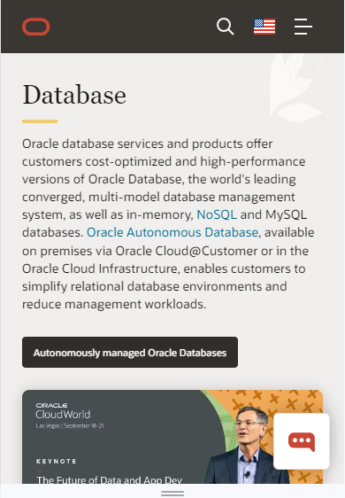
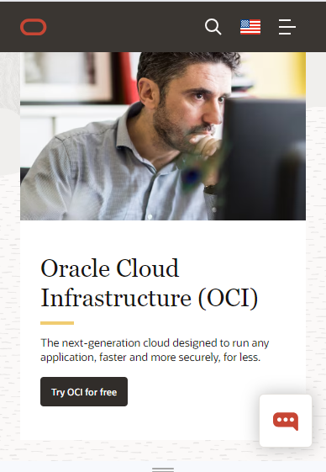
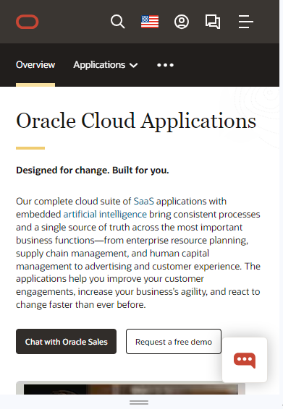
HOME
OCI
Database
OCI
OCA

Slide 14

Suggestions
The website needs more colorful backgrounds it is very simple – Not much Attractive
It is not user friendly in mobile
The page doesn't load too fast
Cookies pop-ups are disappointing while opening the website
The website seems to not much attractive can add much more innovative images

Slide 15
List of Best Practices For Creating Visually Appealing and User-friendly Website Designs

Slide 16
Responsive Design: Ensure your website is responsive and adapts well to various screen sizes and devices, including desktops, tablets, and smartphones.
Simple and Clean Layout: Use a clean and organized layout with plenty of whitespace to avoid clutter and make content easy to digest.
Clear Navigation: Design intuitive and easy-to-use navigation menus that help users find what they're looking for quickly and easily.
Consistent Branding: Maintain consistency in branding elements such as colors, fonts, and imagery across all pages to reinforce your brand identity.
Readable Typography: Choose legible fonts and ensure adequate contrast between text and background colors to improve readability.
High-Quality Imagery: Use high-quality images and graphics that are relevant to your content and enhance visual appeal.
Visual Hierarchy: Arrange content elements in a way that guides users' attention and communicates the importance of different information on the page.
Fast Loading Speed: Optimize website performance to ensure fast loading times, which can improve user experience and reduce bounce rates.
Accessible Design: Design your website with accessibility in mind, making sure it's usable by people with disabilities and complies with accessibility standards.

Slide 17
Mobile-Friendly Features: Implement mobile-friendly features such as touch-friendly buttons, simplified navigation, and mobile-specific optimizations to enhance the experience for mobile users.
Interactive Elements: Incorporate interactive elements like buttons, forms, and animations to engage users and make the website more dynamic.
Whitespace and Padding: Use ample whitespace and padding around elements to improve visual clarity and make the content easier to read and interact with.
Call to Action (CTA) Buttons: Design clear and compelling CTAs that stand out and encourage users to take desired actions such as making a purchase or signing up for a newsletter.
User Testing: Conduct usability testing with real users to identify pain points, gather feedback, and make iterative improvements to the design.
Stay Updated: Stay informed about current design trends, best practices, and emerging technologies to keep your website design fresh and relevant.

Slide 18
Landing Page Link
https://www.figma.com/proto/wmA2lonnhFiA3R7uFNwQ60/Untitled?type=design&node-id=2-29&t=EmqOETMaeeZqiICt-1&scaling=min-zoom&page-id=0%3A1&mode=design

Slide 19
Thank You

